Slide 1
OVERSEAS RECRUITMENT SYSTEM

Slide 2
INTRODUCTION
The project ‘Overseas Recruitment System’ is developed to maintain the details of student information, trace the details of student also maintain the information about the company availability.
Using this project user may know all the details which are provided by this project.
Users can view the availability of company and dates of passing. In the same way in this project one more user is involved he is most important person who is able to controlling all the information and also makes the necessary changes when they raised is called ‘Administrator’

Slide 3
PROBLEM STATEMENT
The company recruits graduates by maintaining manual records which involves many loop holes.
Manual records tend to contain data which are redundant. This is because Normalization followed is consistent data base is missing feature in manual records. Because of redundant data, there is no consistency in the data .
Maintaining each students and employees data with much number of fields is a tedious process and takes more time to retrieve back. An organization data base goes through many numbers of updates each day which is hard to maintain in registers.

Slide 4
OBJECTIVES
Registered graduates should be eligible to apply for one or many available jobs only if the given job requirements match with their skill sets. To ease jobseekers by providing different functionalities to it.
New graduates cannot access the system functionality until they are registered
The employer is responsible to post the job requirements along with the selected student information after the complete recruitment process.

Slide 5
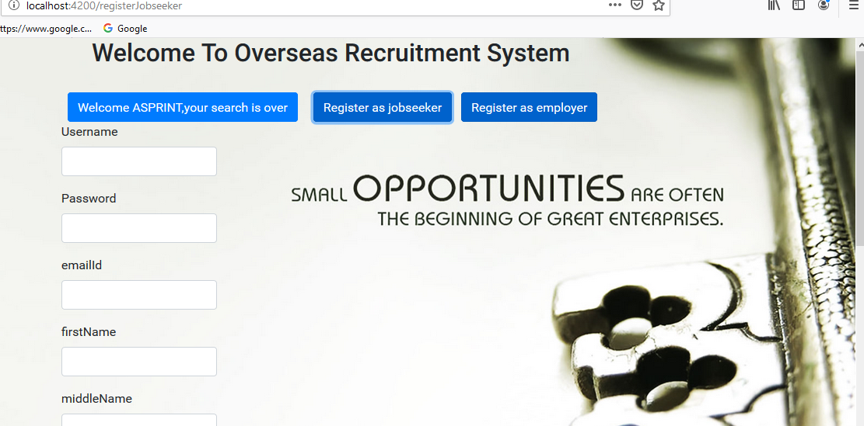
REGISTER PAGE:JOBSEEKER

Slide 6
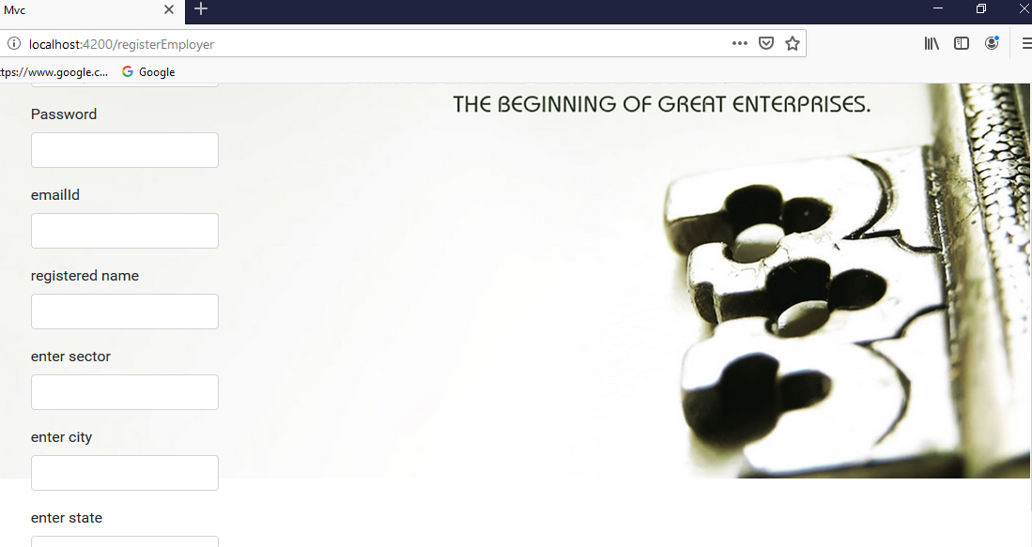
REGISTER PAGE:EMPLOYER

Slide 7
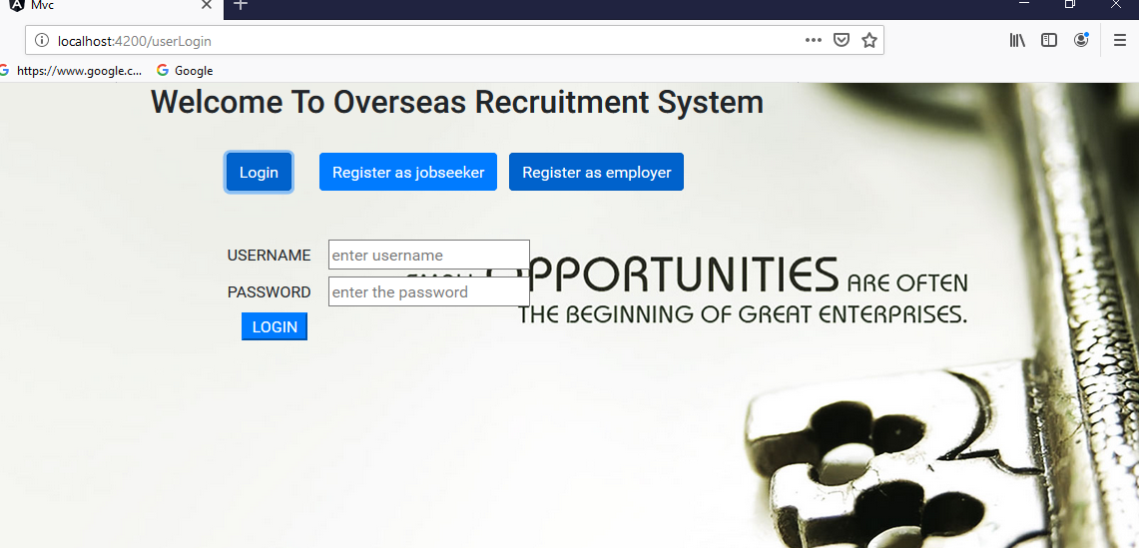
LOGIN PAGE

Slide 8
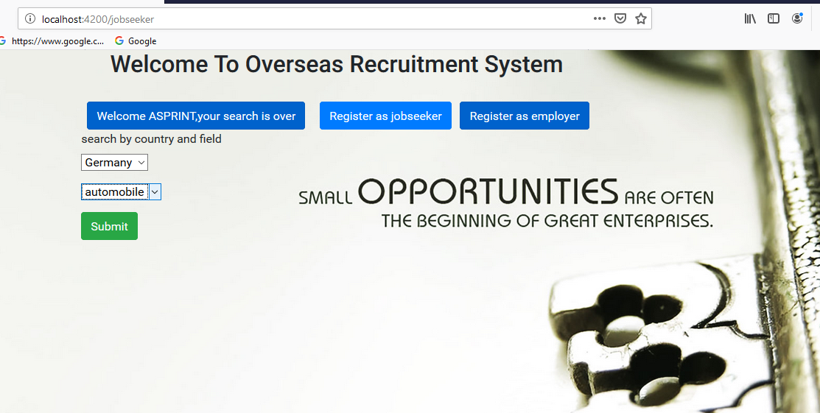
JOBSEEKER:VIEW EMPLOYERS BY COUNTRY AND FIELD

Slide 9
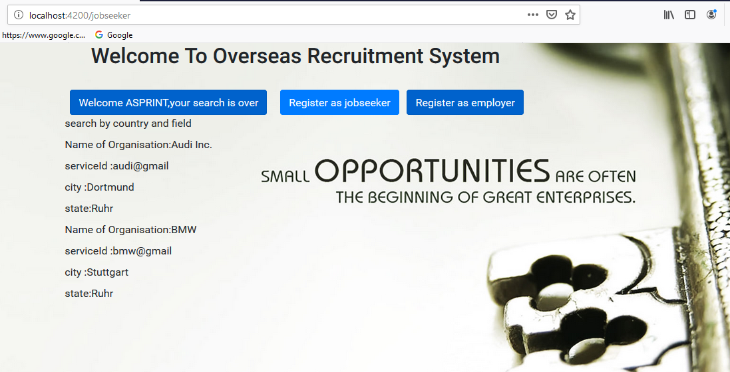
JOBSEEKER:VIEW EMPLOYER

Slide 10
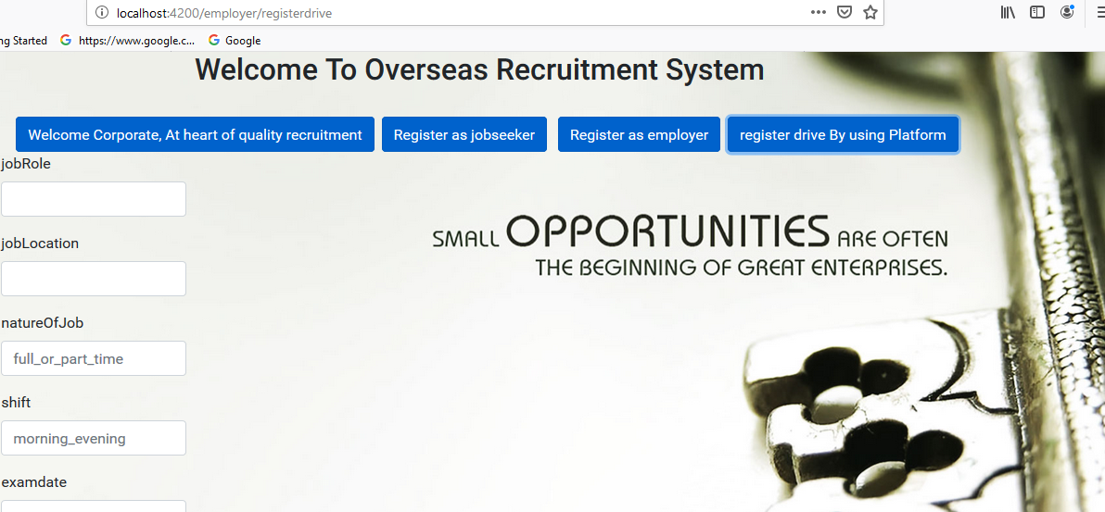
EMPLOYER:REGISTER DRIVE

Slide 11
FUTURE SCOPE
This project can be enhanced further by adding feedback system, in which both job seeker and employer can post their feedback.
Admin can see the feedbacks given.
If the admin sees any violating/explicit feedback by any user, then he will have the authority to report that user.

Slide 12
THANK YOU

